Slide 1
AAI Fund Management System: The Project Fund Workflow

Slide 2
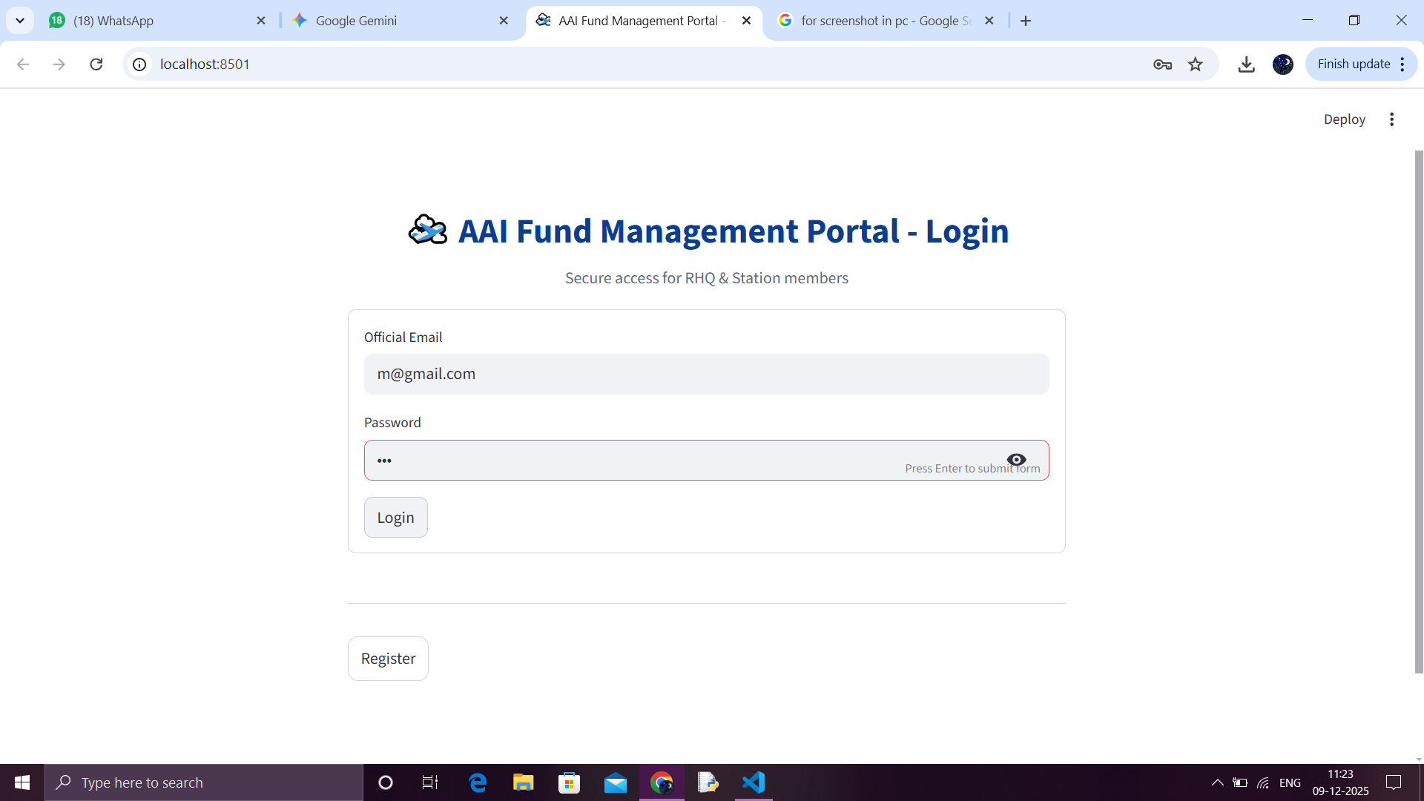
Main Login-in Page

Slide 3
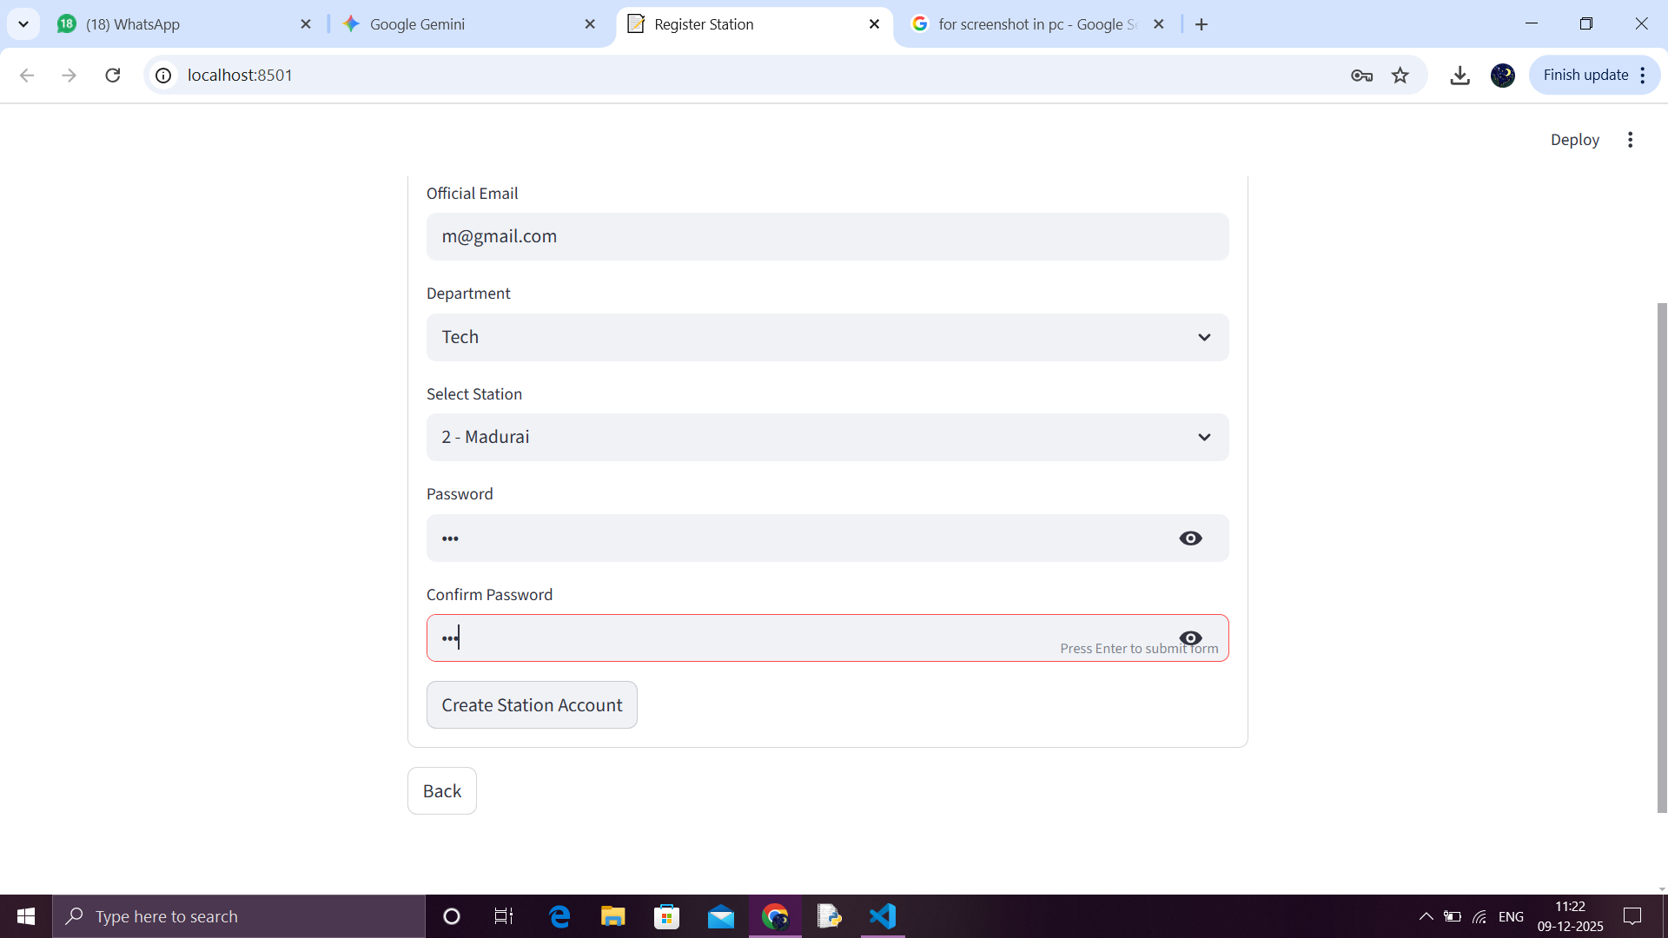
Phase 1: Station Request (Initiation)
System Access and Registration

Slide 4
Secure access is provided via the AAI Fund Management Portal.
New Station Members must register, providing their Official Email, Department (e.g., Tech), and assigned Station (e.g., Madurai) to create an account.
Station Members must register, providing their Official Email, Department (e.g., Tech), and assigned Station (e.g., Madurai) to create an account.
Then the station member can login their on account using their registered G-mail and password.

Slide 5
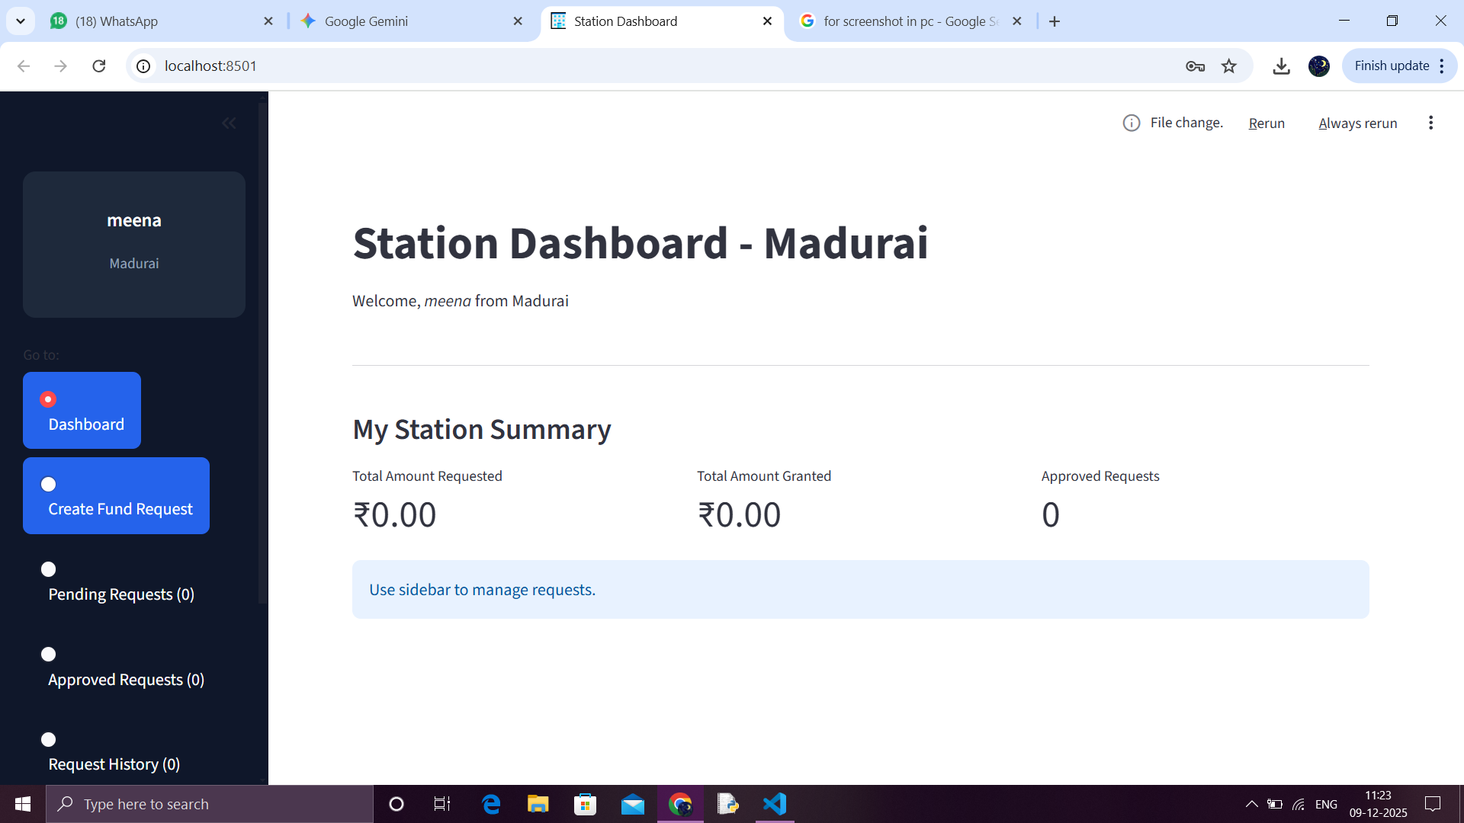
Station Dashboard Overview

Slide 6
The dashboard provides an immediate summary of Total Amount Requested and Total Amount Granted.
Navigation is managed through the sidebar menu. The station staff can use this dashboard to request the fund amount , to view the status of the requested amount .
When the fund amount is approved by the RHQ , then the status will change and will be visible for the respected stations .

Slide 7
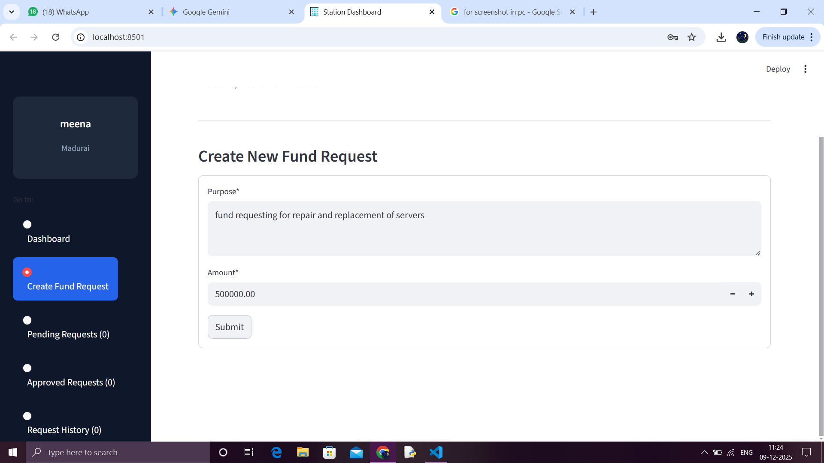
Create Fund Request

Slide 8
The Station initiates the process by entering the project's Purpose (e.g., fund requesting for repair and replacement of servers) and the exact Amount required (e.g., ₹500,000.00).
It is mandatory to fill the purpose of the fund request. And the amount can also be set and the station staff can submit the request.

Slide 9
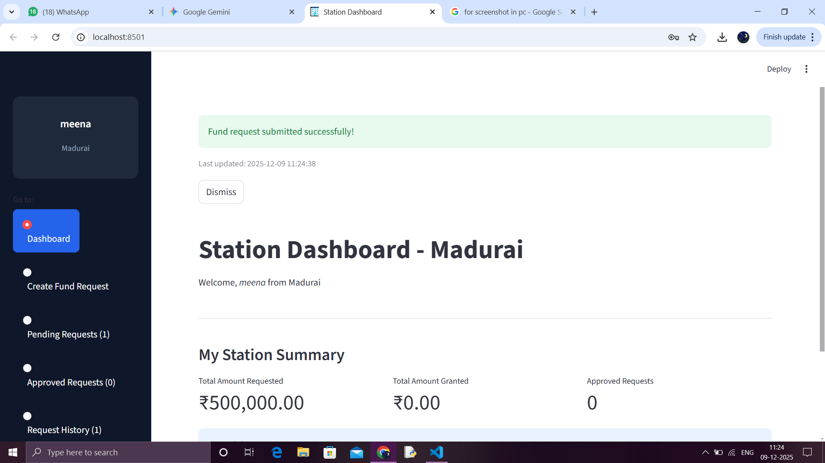
Status Update

Slide 10
Upon submission, the dashboard confirms the submission, and the request is immediately moved to the Pending Requests tab.
The submission is recorded in the pending request and also in the history.
Using this we can access the old data request records for future uses.

Slide 11
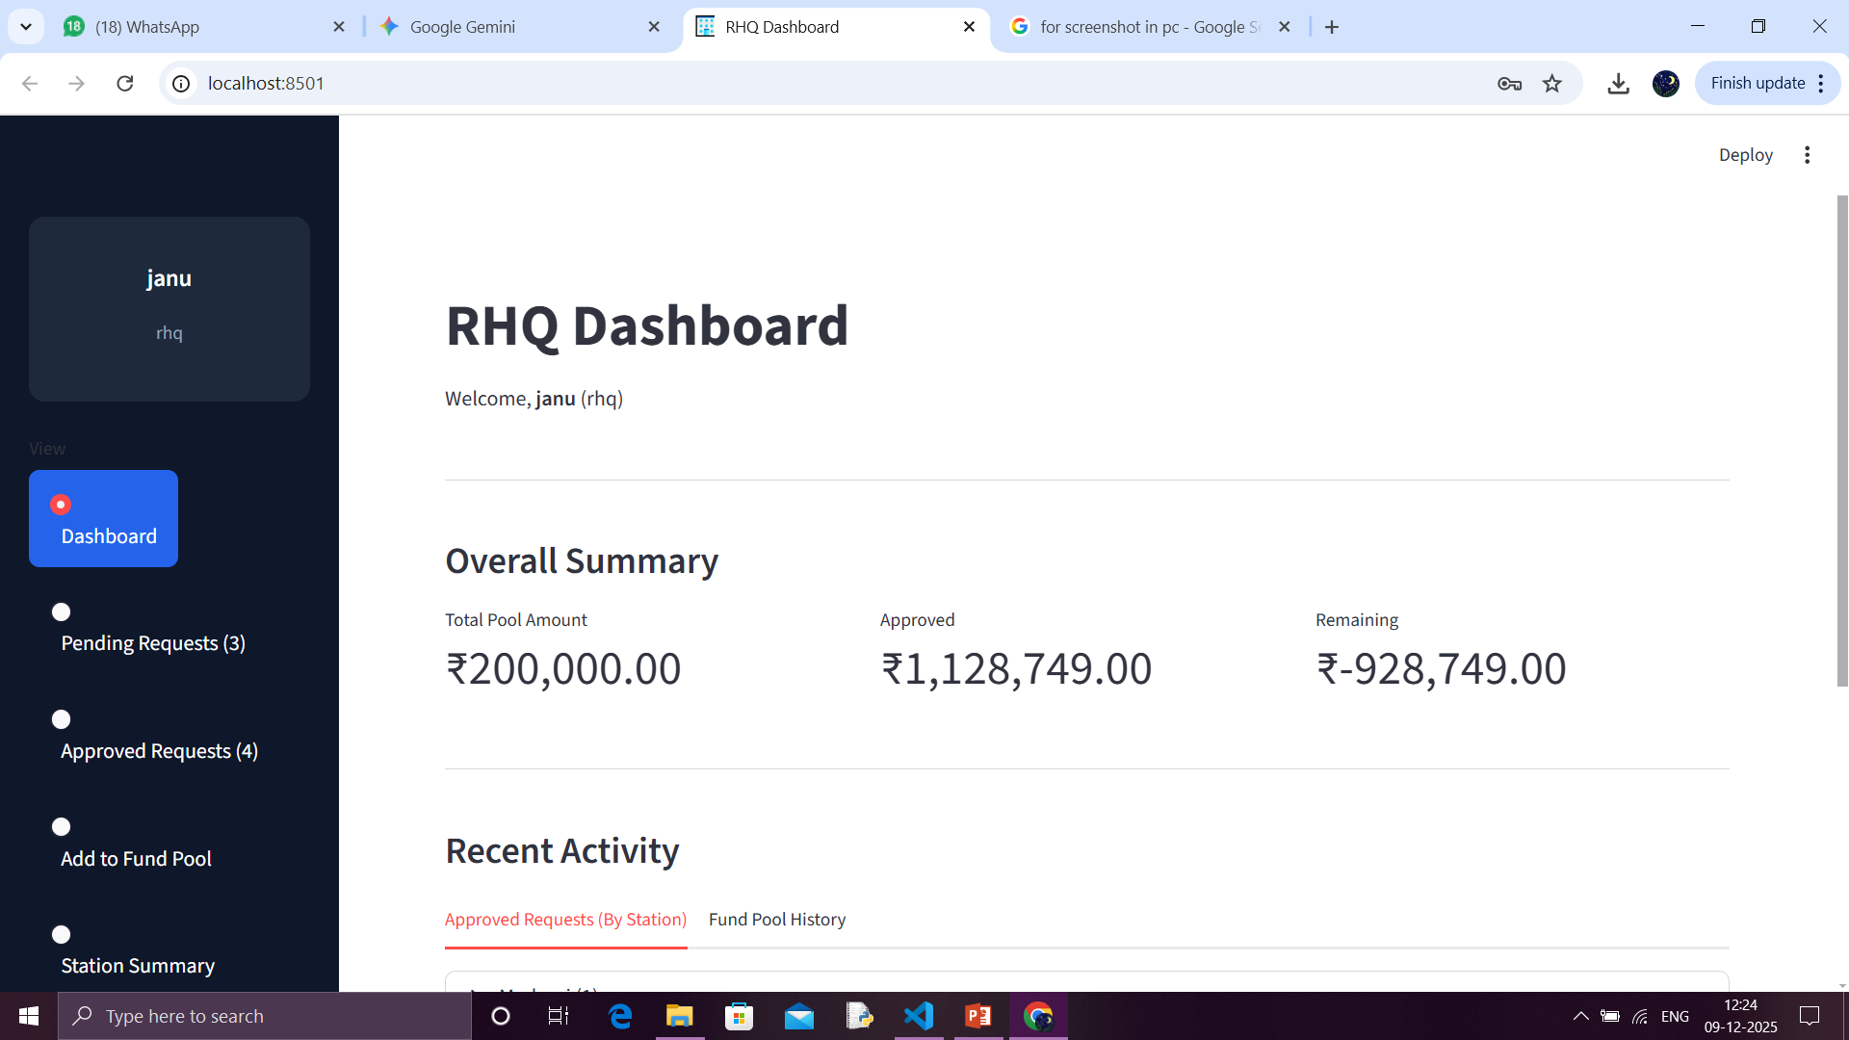
Phase 2: RHQ Review (Approval)
RHQ Dashboard

Slide 12
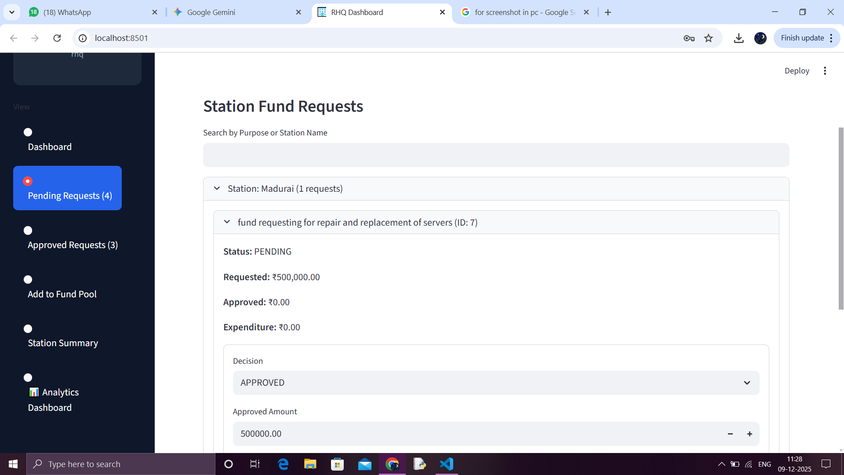
RHQ Pending Requests View

Slide 13
The request appears on the RHQ Dashboard under Pending Requests.
The RHQ authority can review details like the Purpose, Requested Amount, and current Status: PENDING.
If the request is approved it will be moved to approved request.
The capital allotted from CHQ to RHQ can be added into the fund pool ie, the total capital held by the RHQ.
Analytics dashboard is where we can view the recorded raw data in visualization .

Slide 14
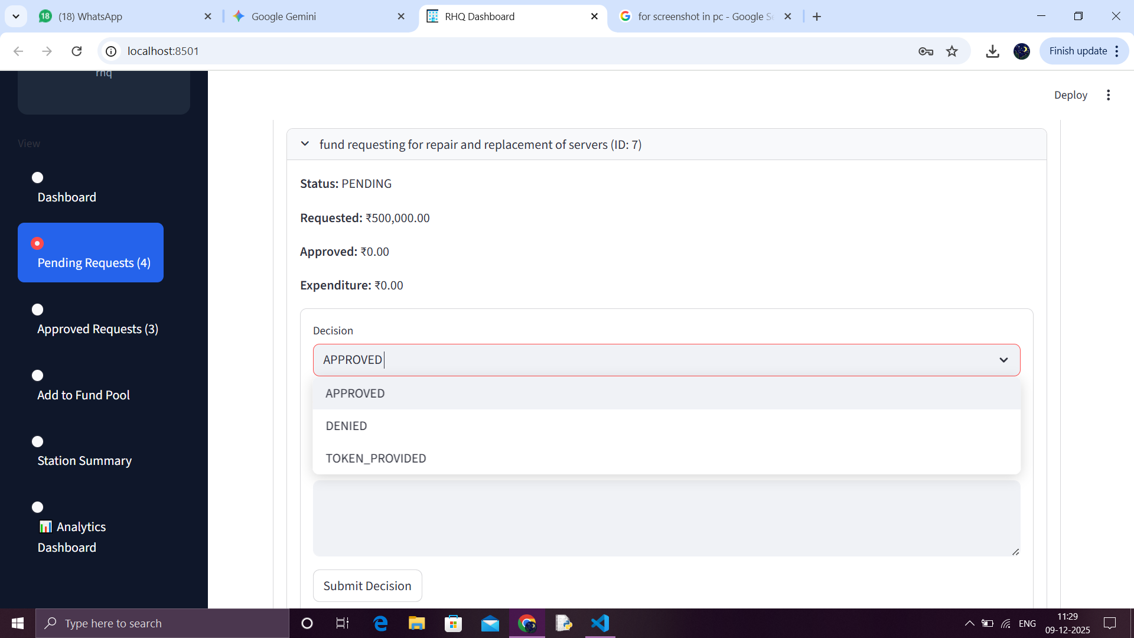
Decision Making

Slide 15
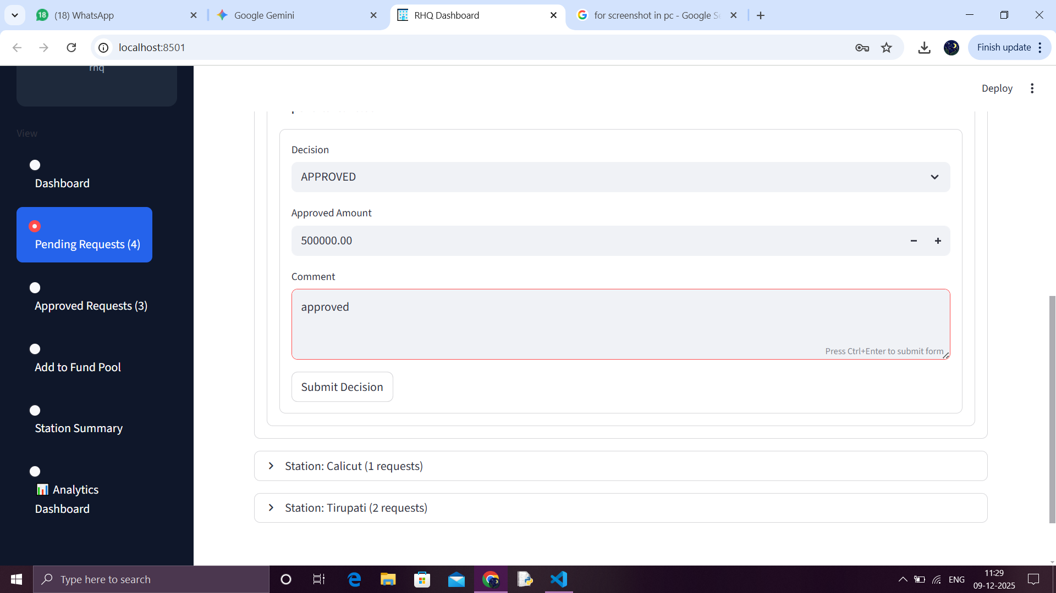
Sanction and Comment, RHQ Confirmation

Slide 16
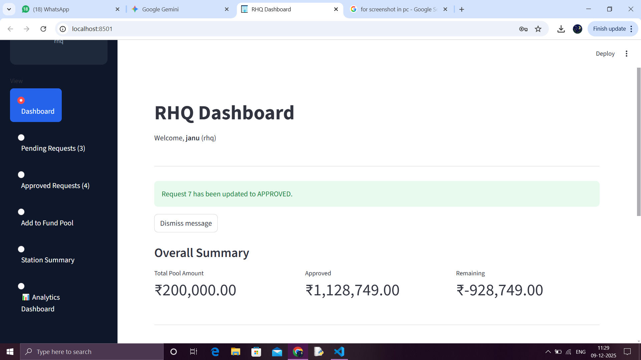

Slide 17
The request appears on the RHQ Dashboard under Pending Requests. The RHQ authority can review details like the Purpose, Requested Amount, and current Status: PENDING.
The RHQ user selects the Decision from a dropdown menu, choosing between APPROVED, DENIED, or TOKEN_PROVIDED.
The exact Approved Amount is entered (which may differ from the requested amount), and a mandatory Comment (approved) is added for documentation before the decision is submitted.
Confirmation the RHQ Dashboard confirms the transaction, and the request moves to the RHQ Approved Requests list. The overall RHQ fund summary is updated.

Slide 18
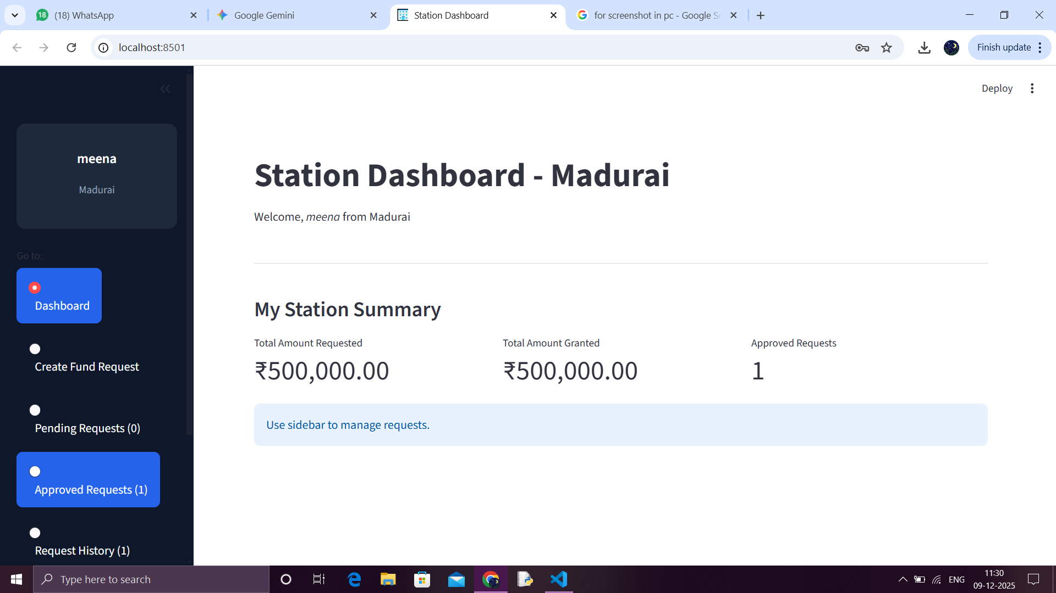
Phase 3: Work Award & Fund Allocation (Closure)

Slide 19
Work Award / Fund Allocation
The Station Dashboard is updated:
Total Amount Granted now reflects the approved amount (₹500,000.00), and the Approved Requests count is set to (1).
This signifies the allocation of funds for the work.

Slide 20
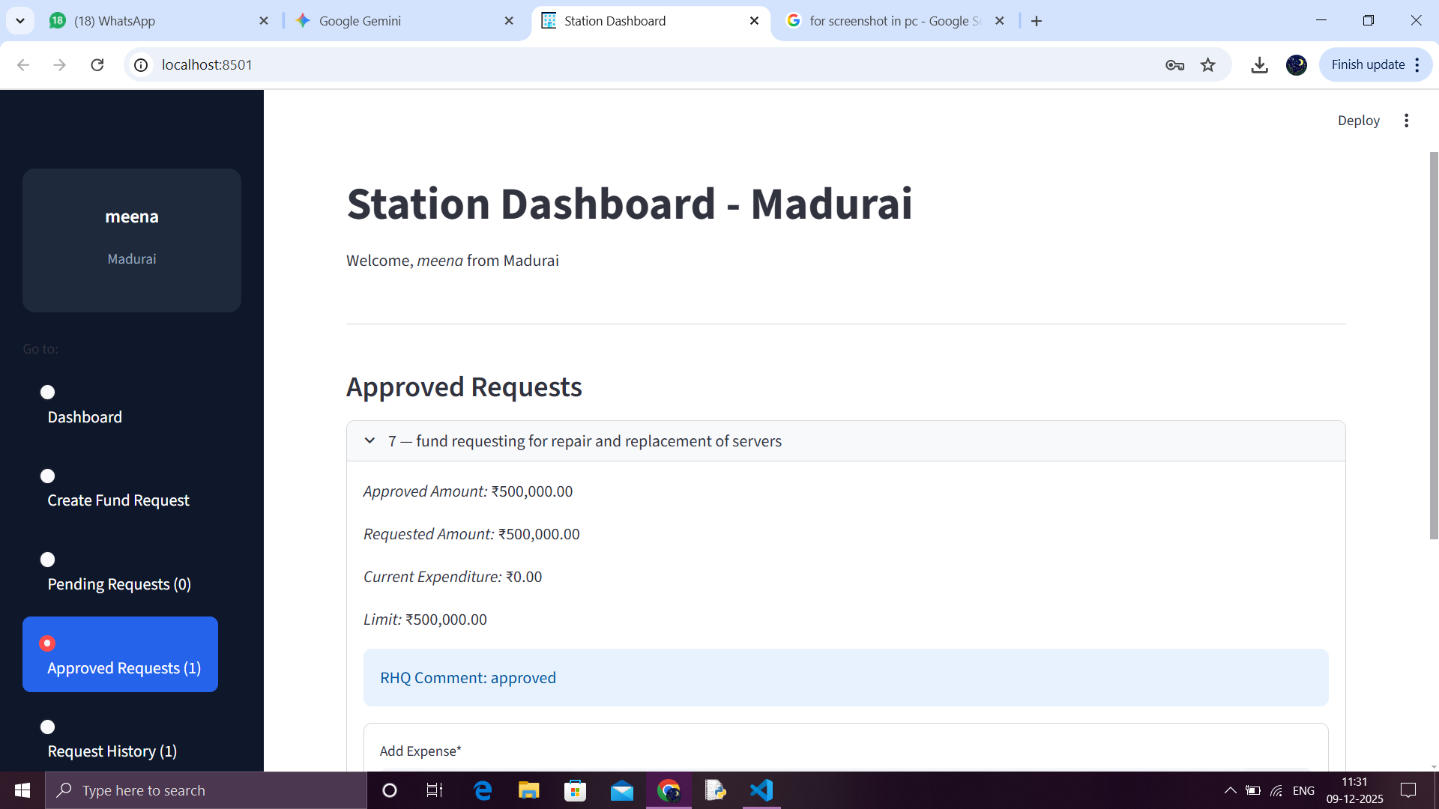
Approved Request Details

Slide 21
The Station views the request under the Approved Requests tab, confirming the Approved Amount, Limit, and the RHQ Comment.
Next Step: Expenditure
The Add Expense feature becomes available.
This is the mechanism used to track project expenditure and fulfill the conceptual steps of Bidding, Work Award, and eventually, Work Completion/Payment Entry.

Slide 22
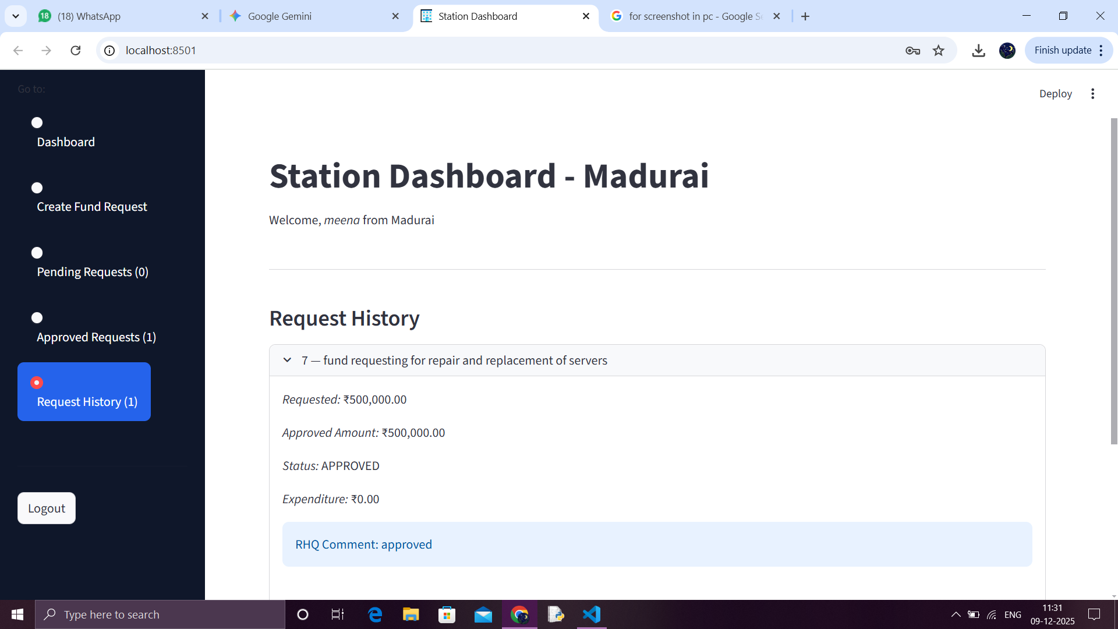
History and Audit
All approved requests, including the status and RHQ comments, are permanently logged in the Request History tab for auditing.

Slide 23
Summary & Key Benefits
The system provides a seamless digital flow from Station request initiation to RHQ approval, ensuring the necessary checks and balances are met before fund allocation.
Transparency & Tracking Statuses are updated in real-time, providing transparency for both the requesting Station and the approving RHQ.
The system captures the approved amount, decision, and comments, creating a clear audit trail for the Fund Management process.

